Slide 1


TEAM 7
KAVYASHREE UPENDRA - 002921251
SAI SUPRIYA KOMARRAJU -002960655
SHARAN BALASUBRAMANIYAN - 002920078
SHRIYA DIKSHIT – 002921535
SINDHU SRINIVAS PRASAD -00292301
VRUSHANK HIREMATH - 002926888
CUSTOMER COMPLAINTS MANAGEMET SYSTEM

Slide 2
CONTRIBUTION
KAVYASHREE UPENDRA - DDL, Data Insertions, Procedures, Functions, Packages
SAI SUPRIYA KOMARRAJU – DDL, Data Insertions, Triggers, Indexes, PPT
SHARAN BALASUBRAMANIYAN - DDL, Data Insertions, Business Reports, Views, Documentation
SHRIYA DIKSHITH – DDL, Data Insertions, Procedures, Packages, Functions, Users, Documentation
SINDHU SRINIVAS PRASAD – DDL, Data Insertions, Business Reports, Views, PPT
VRUSHANK HIREMATH – DDL, Insertions, Triggers, Indexes, Documentation

Slide 3
CONCEPTS
BUSINESS IMPLEMENTATIONS
ERD
PROBLEM STATEMENT
REPORTS

Slide 4

BUSINESS IMPLEMENTATIONS
Maintaining Customer Complaints
Case Handling by Employee
Part Replacement
Case Resolution
Customer Feedback & Customer Retention
Warranty Subscription
Service Fee

Slide 5
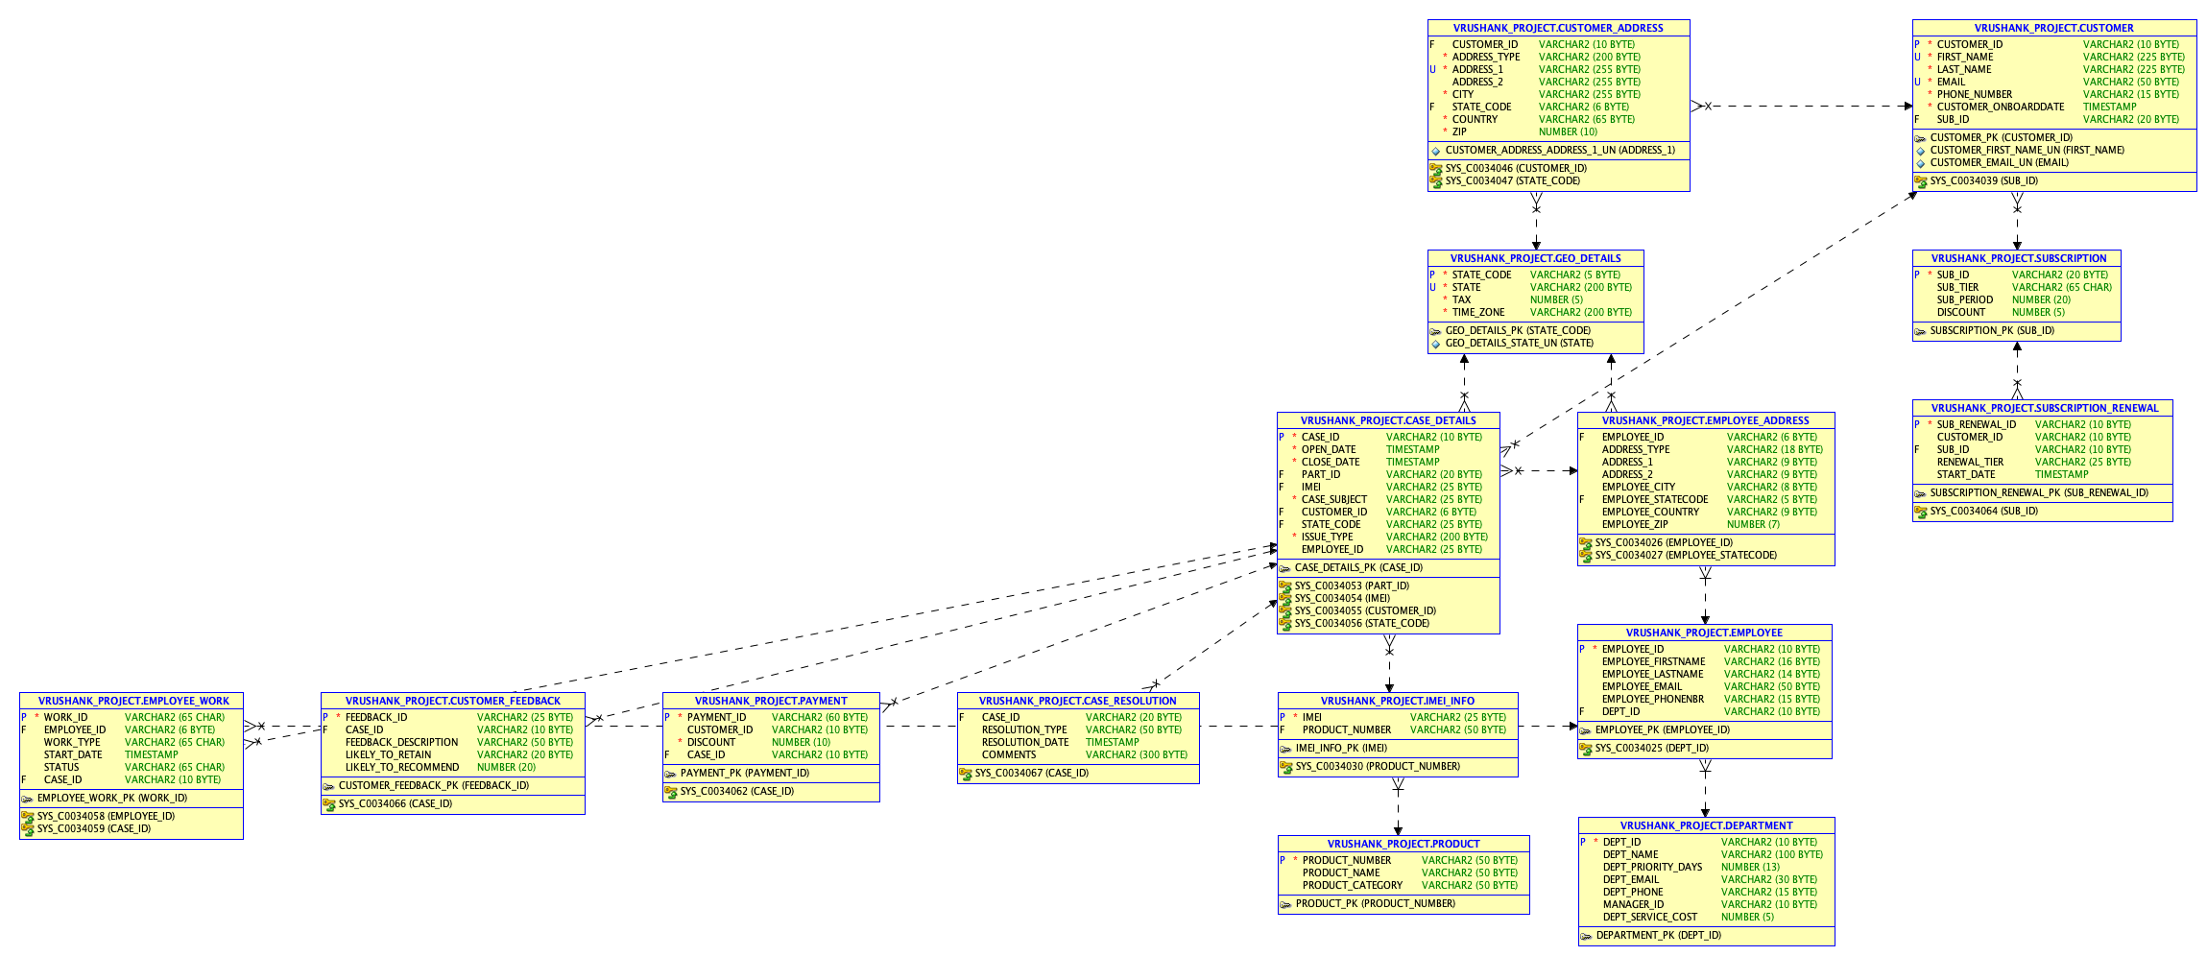
ERD

Slide 6
PROBLEM STATEMENT
The purpose of this database is to maintain customer complaints and hold the issues about products, accounts, payments and other services for a particular warranty period.
Through this customer retention can be achieved by resolving the case within the stipulated time and helping them track the status of their case.
Cost is calculated based on warranty details recorded in the customer data created by customer care
If the replacements/fixes are done within estimated time of resolution, then there is a high chance of customer retention
Users should be able to see where exactly their cases are stuck (which team).
If the replacements/fixes are done within estimated time of resolution, then there is a high chance of customer retention
As a result, client happiness determines the company's growth or decline, and the company can only grow if we work towards retaining and extracting more value from them.

Slide 7

REPORTS

Slide 8
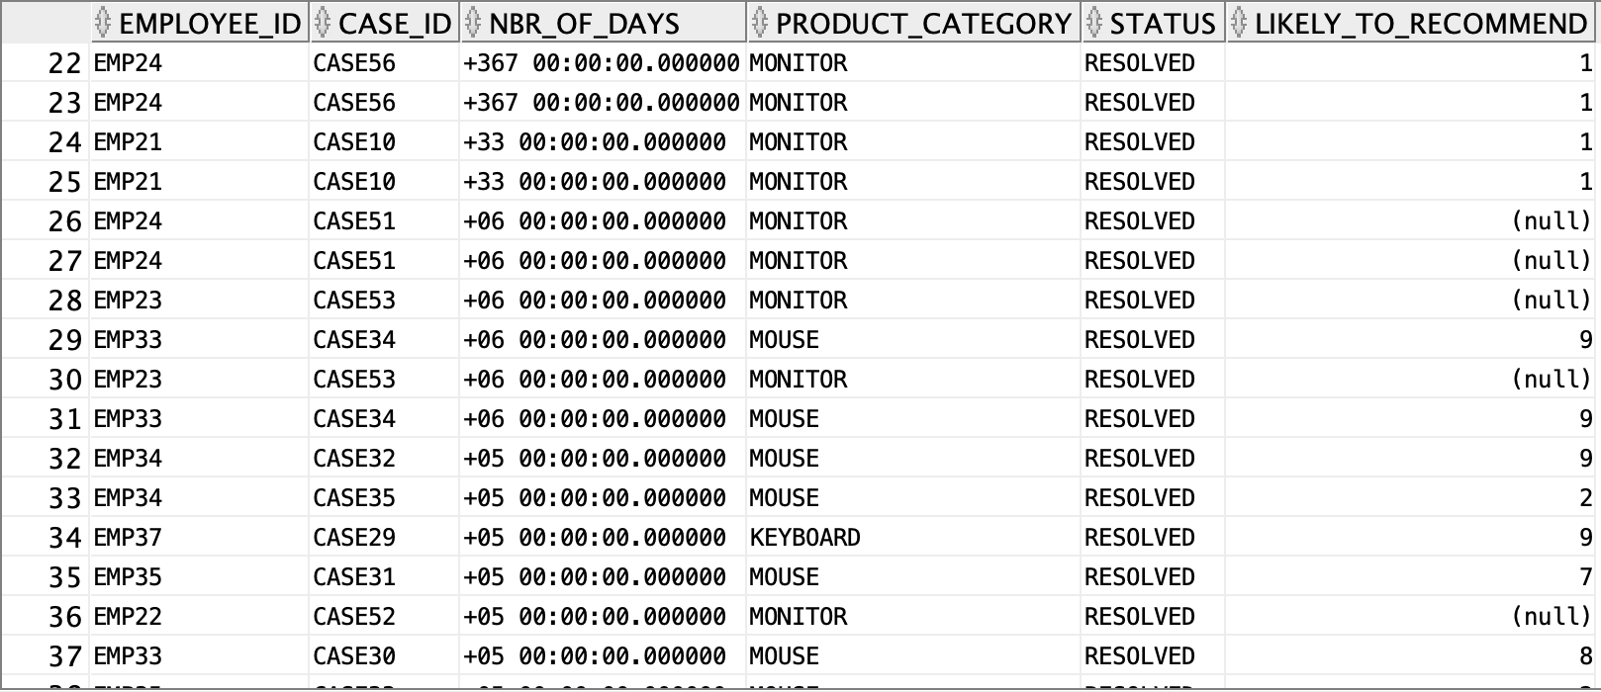
1. EMPLOYEE EFFICIENCY
Listing the efficient employees
PURPOSE:
To list all the employees to check status of the case
SOLUTION:
By taking resolution date and open date to check the number of days spent on solving the case and update the status to get how likely the customer is to retain

Slide 9
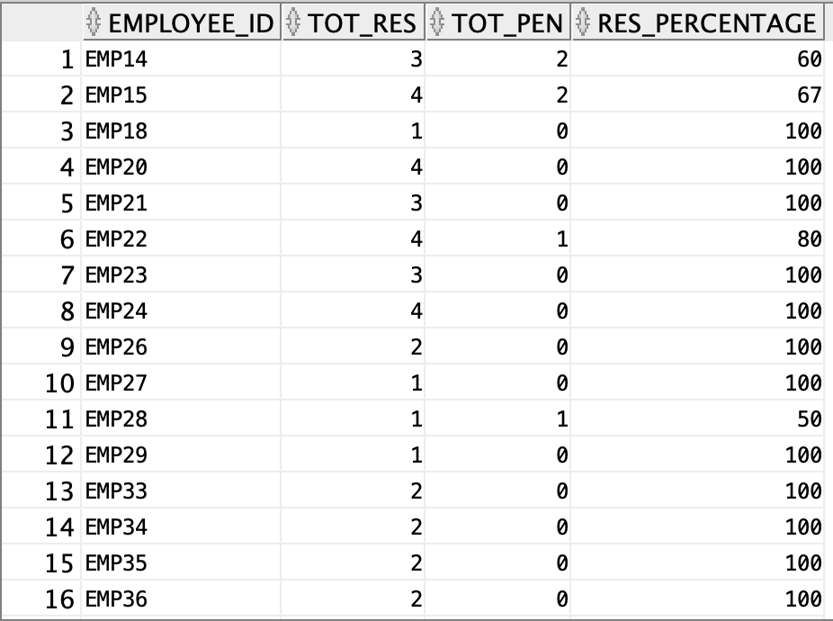
2. EMPLOYEE EFFICIENCY
PURPOSE :
To check employee efficiency depending on the percentage of resolution
SOLUTION:
Calculating resolution percentage of each employee depending on the number of cases they have resolved by total number of cases assigned to them.

Slide 10
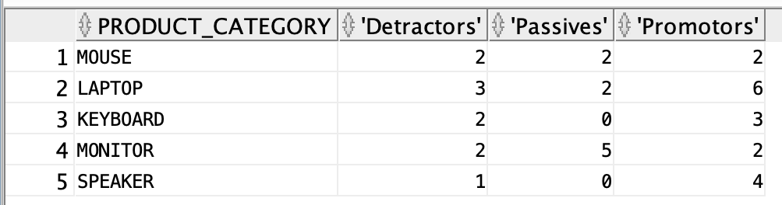
3. PRODUCT, PROMOTERS, DETRACTORS, PASSIVES
PURPOSE:
To find products that require improvement with respect to quality.
SOLUTION:
The higher the number of promoters, the higher the number of consumers who are likely to stay, implying that the products are less defective.
The more number of detractors indicate that number of customers who are likely to retain are low which in turn indicates the products are more defective

Slide 11
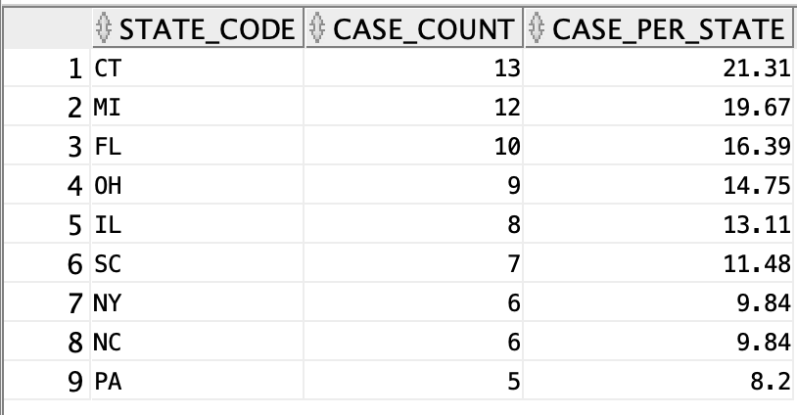
4. CASES PER STATE
PURPOSE:
To check which geo location has the most number of case per state
SOLUTION:
By calculating the number of case count from the case table we get the top 9 states from where we get most cases.

Slide 12
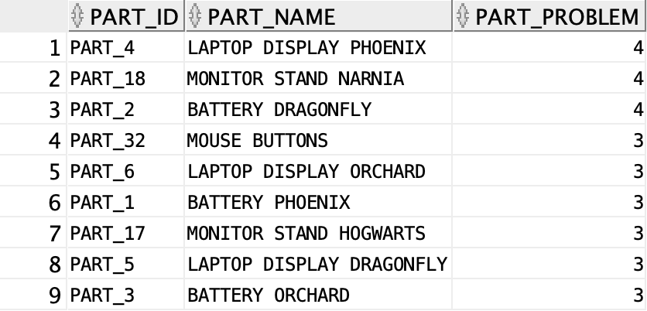
5. PROBLEMATIC PARTS
PURPOSE:
To find parts that are most problematic
SOLUTION:
Part problem indicates the number of times the respective part has caused problem or has required a replacement

Slide 13
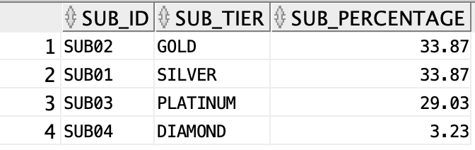
6. TIER WEIGHTAGE
PURPOSE:
To find highest number of subscriptions used by a set of customers
SOLUTION:
To help the analyst in finding which Subscription to focus on to increase customers

